Slide 1
Covenant, Privilege and Joy
Carolyn Hayes, Ph.D., RN, NEA-BC
president/executive director
Greater Boston Nursing Collective

Slide 2
Objectives
Participants will learn about how Nursing’s ethical foundation establishes a covenant with members of society and shapes our individual and collective world view.
Participants will learn about how Nursing is practiced as a privilege and public trust.
Participants will learn about the links between their covenant and privilege as means to generate joy in their practice.

Slide 3
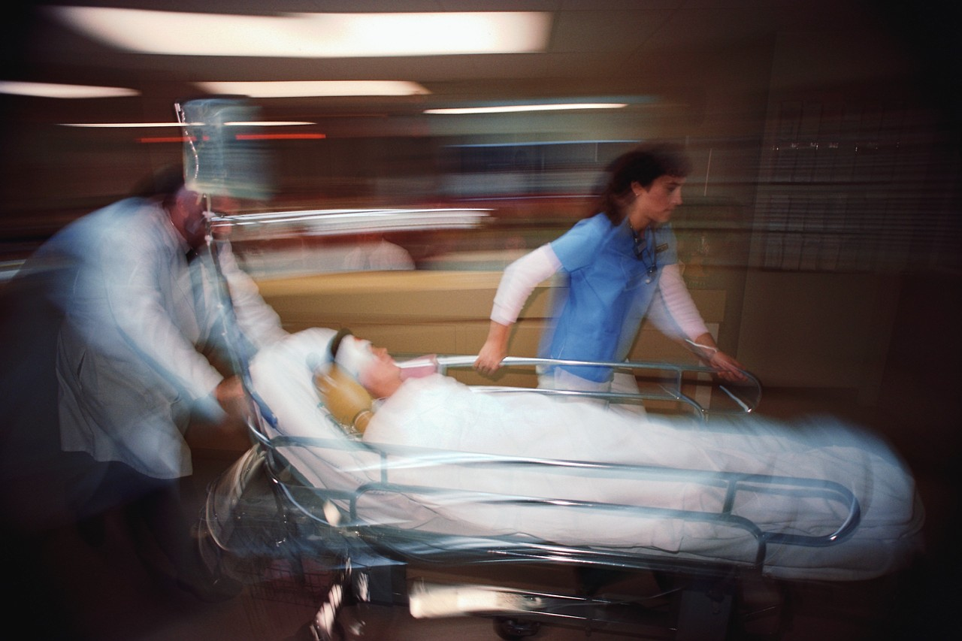
I know how you will live your day…how will you live your professional life?

Slide 4
Joy
1 a : the emotion evoked by well-being, success, or good fortune or by the prospect of possessing what one desires : delight b : the expression or exhibition of such emotion : gaiety 2 : a state of happiness or felicity : bliss 3 : a source or cause of delight
Synonyms
beatitude, blessedness, bliss, blissfulness, felicity, gladness, happiness
Antonyms
calamity, ill-being, misery, sadness, unhappiness, wretchedness

Slide 5
Nobility (n.)
The state of being in one’s character, mind, birthright, rank. Associated with dignity, goodness and courage.
The Joy of Nursing: reclaiming our nobility (Adams)

Slide 6
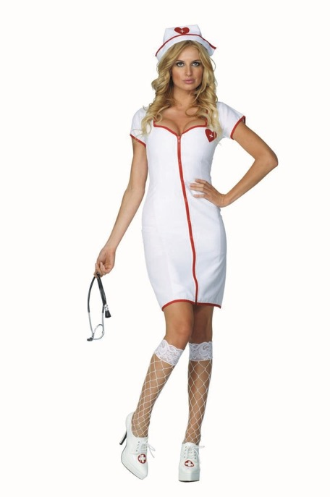
Image of Nursing
Likely to get either image when searching for “nurse”.

Slide 7
https://www.youtube.com/watch?v=gTMuh6AF3A0

Slide 8
 | Very High | High | Average | Low | Very Low
 | % | % | % | % | %
Nurses | 27 | 55 | 16 | 1 | 1
Military officers | 22 | 49 | 24 | 2 | 1
Grade school teachers | 20 | 46 | 27 | 4 | 1
Medical doctors | 16 | 49 | 31 | 4 | *
Pharmacists | 13 | 49 | 32 | 5 | 1
Police officers | 16 | 40 | 32 | 8 | 4
Day care providers | 8 | 38 | 43 | 5 | 2
Judges | 7 | 36 | 41 | 12 | 3
Clergy | 11 | 31 | 41 | 10 | 3
Auto mechanics | 5 | 27 | 53 | 12 | 2
Nursing home operators | 5 | 21 | 48 | 18 | 4
Newspaper reporters | 5 | 20 | 39 | 21 | 14
Bankers | 4 | 21 | 54 | 16 | 5
Local officeholders | 3 | 21 | 53 | 16 | 4
TV reporters | 5 | 18 | 39 | 23 | 14
State officeholders | 1 | 18 | 47 | 25 | 8
Lawyers | 4 | 14 | 53 | 19 | 9
Business executives | 2 | 14 | 54 | 20 | 8
Advertising practitioners | 2 | 10 | 49 | 26 | 8
Members of Congress | 2 | 9 | 29 | 36 | 24
Car salespeople | 2 | 8 | 48 | 29 | 10
Lobbyists | 2 | 6 | 31 | 33 | 25
Notes:
Please tell me how you would rate the honesty and ethical standards of people in these different fields -- very high, high, average, low or very low? How about -- [RANDOM ORDER]?
To be fair to Congress - they are practically tied with car salespeople and lobbyists.
where does that trust come from and how do we stay at the top of the heap

Slide 9
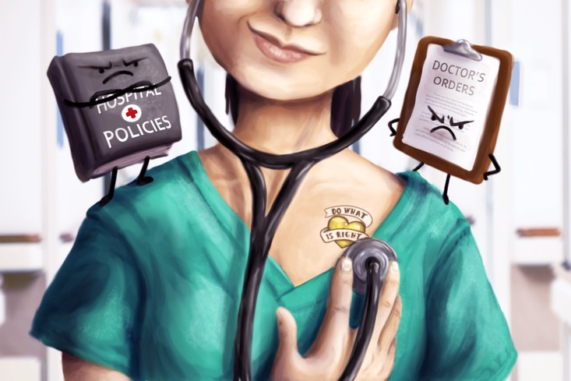
Moral Accountability
Being answerable to someone for something one has done or for the responsibilities associated with a particular role assumed by the individual. It includes providing an explanation or rationale according to public standards/norms. The standards/norms of moral accountability are specified by codes of ethics and practice standards.
Fry, S. (1994) Ethics in Nursing Practice, International Council of Nurses
Notes:
Advocacy
Accountability/Responsibility
Cooperation
Caring

Slide 10
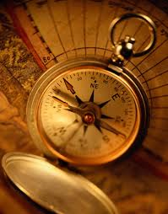
Moral Agency
The capacity for a person to act morally/ethically on his own (moral) authority.
Fry, 1994.

Slide 11
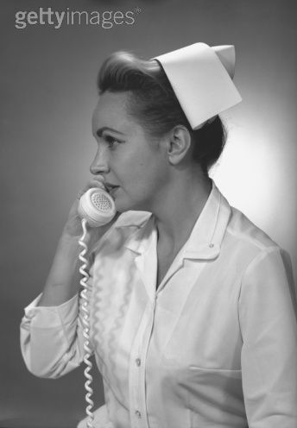
Clinical Ethics
Principles
Codes of ethics (2015)
Professional organization position statements
Social Policy Statements
Practice Acts

Slide 12
Contract versus Covenant
What is a Contract?
In simple terms, a contract is an oral or written promise that is enforceable by law. It is defined in law as a voluntary agreement between two or more parties, who intend to create legal obligations, in which there is a promise to do or perform some work or service for a valuable consideration or benefit.
What is a Covenant?
A covenant is defined as an agreement or written promise between two or more parties that constitutes a pledge to do or refrain from doing something. Thus, an agreement that requires the performance of some act is termed an “affirmative covenant” while an agreement that restricts or refrains a person from performing something is called a “negative covenant.”
The nature of a covenant may take several forms: it may be a mutual covenant wherein both parties agree to perform something at the same time; it may be a dependent covenant or even an independent covenant.

Slide 13
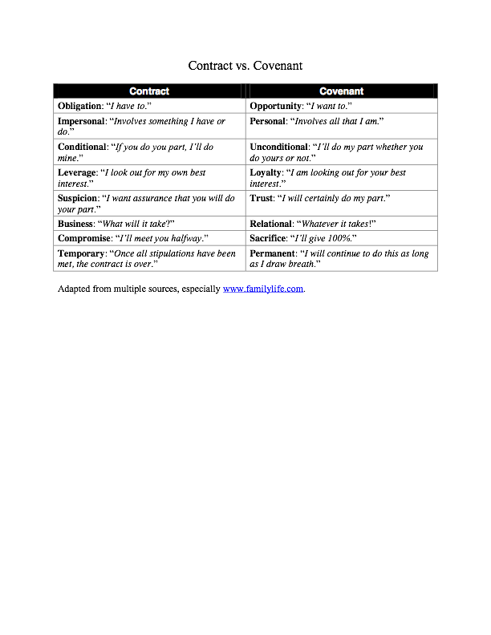

Slide 14
ANA Social Policy Statement
Guide to Nursing's Social Policy Statement : Understanding the Profession from Social Contract to Social Covenant
Marsha Diane Mary Fowler

Slide 15
5.3 Preservation of Wholeness of Character
“Nurses have both personal and professional identities that are integrated and that embrace the values of the profession, merging them with personal values. Authentic expression of one’s own moral point of view is a duty to self. Sound ethical decision-making requires the respectful and open exchange of views among all those with relevant interests. Nurses must work to foster a community of moral discourse. As moral agents, nurses are an important part of that community and have a responsibility to express moral perspectives, especially when such perspectives are integral to the situation, whether or not those perspectives are shared by others and whether or not they might prevail.”

Slide 16
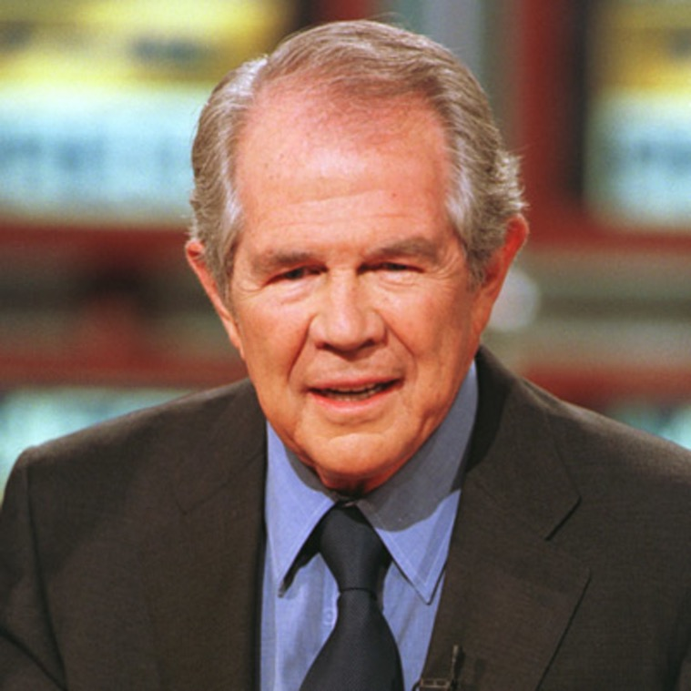
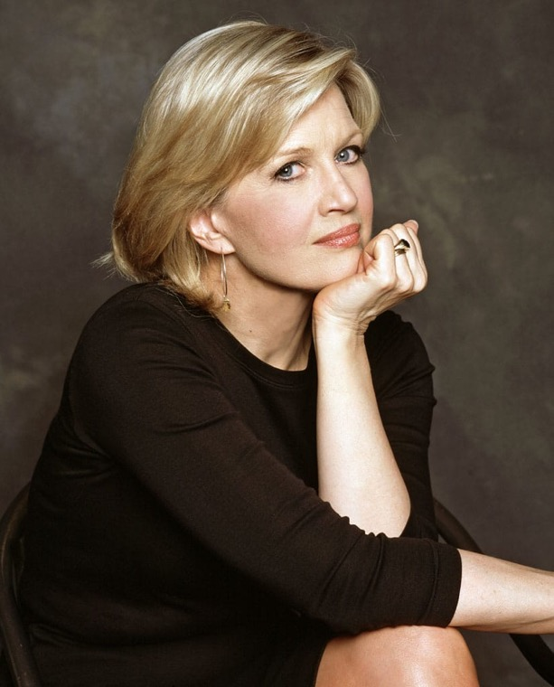
Contemporary Example of Whole-Person Worldview
Pat Robertson/ABC news

Slide 17
Current Issues

Slide 18
If we are to go on living together on this earth,
We must all be responsible for it.
Kofi Annan, Nobel Peace Prize Winner

Slide 19
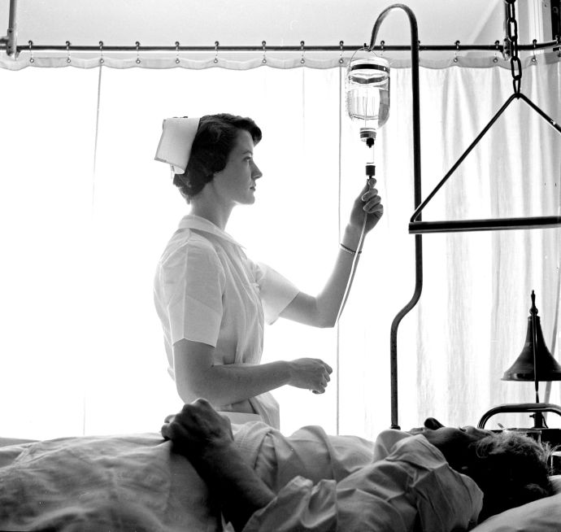
Examples from practice
https://www.youtube.com/watch?v=zcZ92AXDVMc
Notes:
PVA white gown with green stickers
I couldn’t physically or emotionally help him
isolation
Stuck half way between genders

Slide 20
Time is of the essence, but what is the essence of time? (Karan Varsheni)

Slide 21
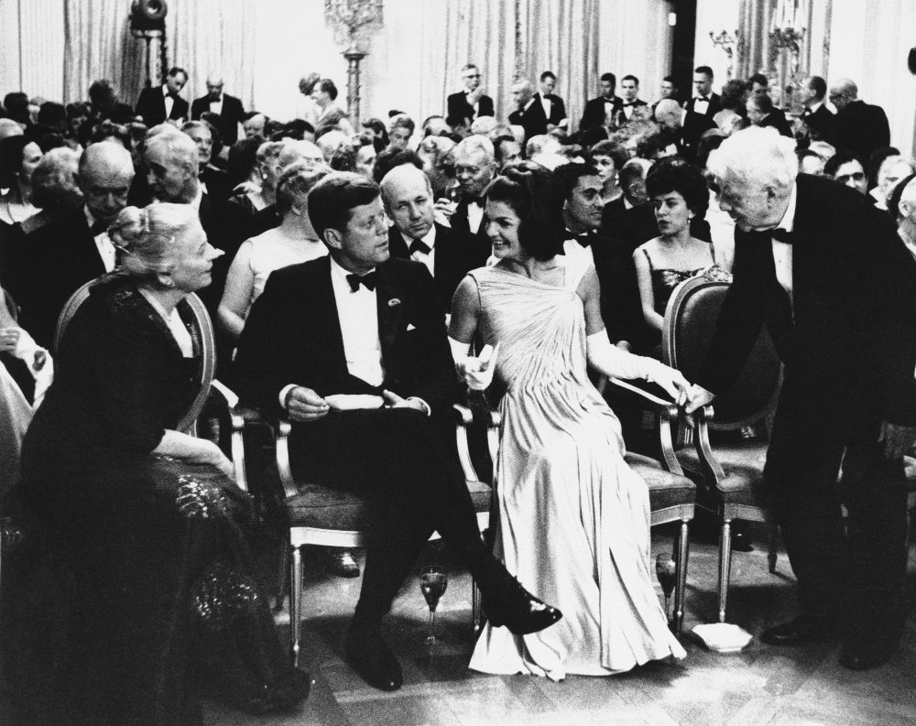
Why the Art of Nursing?

Slide 22
We Are Seven
William Wordsworth

Slide 23
We Are Seven
BY WILLIAM WORDSWORTH
———A simple Child,
That lightly draws its breath,
And feels its life in every limb,
What should it know of death?
I met a little cottage Girl:
She was eight years old, she said;
Her hair was thick with many a curl
That clustered round her head.
She had a rustic, woodland air,
And she was wildly clad:
Her eyes were fair, and very fair;
—Her beauty made me glad.
“Sisters and brothers, little Maid,
How many may you be?”
“How many? Seven in all,” she said,
And wondering looked at me.

Slide 24
“And where are they? I pray you tell.”
She answered, “Seven are we;
And two of us at Conway dwell,
And two are gone to sea.
“Two of us in the church-yard lie,
My sister and my brother;
And, in the church-yard cottage, I
Dwell near them with my mother.”
“You say that two at Conway dwell,
And two are gone to sea,
Yet ye are seven! I pray you tell,
Sweet Maid, how this may be.”
Then did the little Maid reply,
“Seven boys and girls are we;
Two of us in the church-yard lie,
Beneath the church-yard tree.”
“You run about, my little Maid,
Your limbs they are alive;
If two are in the church-yard laid,
Then ye are only five.”

Slide 25
“Their graves are green, they may be seen,”
The little Maid replied,
“Twelve steps or more from my mother’s door,
And they are side by side.
“My stockings there I often knit,
My kerchief there I hem;
And there upon the ground I sit,
And sing a song to them.
“And often after sun-set, Sir,
When it is light and fair,
I take my little porringer,
And eat my supper there.
“The first that died was sister Jane;
In bed she moaning lay,
Till God released her of her pain;
And then she went away.

Slide 26
“So in the church-yard she was laid;
And, when the grass was dry,
Together round her grave we played,
My brother John and I.
“And when the ground was white with snow,
And I could run and slide,
My brother John was forced to go,
And he lies by her side.”
“How many are you, then,” said I,
“If they two are in heaven?”
Quick was the little Maid’s reply,
“O Master! we are seven.”
“But they are dead; those two are dead!
Their spirits are in heaven!”
’Twas throwing words away; for still
The little Maid would have her will,
And said, “Nay, we are seven!”

Slide 27
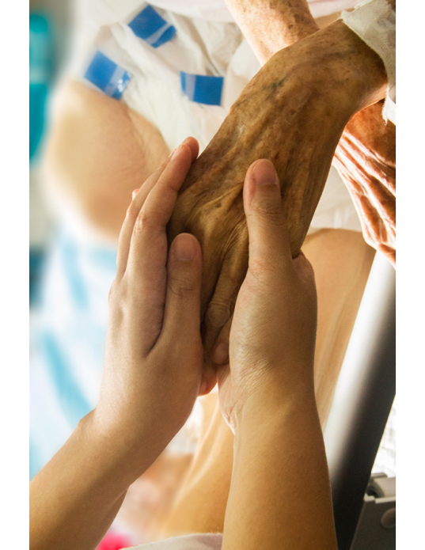
Anytime you take strangers agony into your own body, you are changed by it, refined into a vessel better able to give and receive love.
Mary Karr, English Professor and author, The Liar’s Club

Slide 28
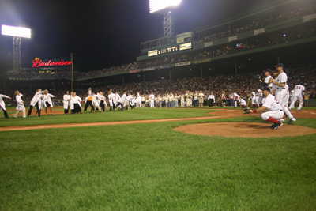
Vocation - The place where your deep gladness meets the world’s greatest needs.
Frederick Buechner, Wishful Thinking: A Theological ABC

Slide 29
If one is lucky, one solitary fantasy can totally transform one million realities.
Maya Angelou

