Slide 1
Integrative Nursing and You Cultivating Wellbeing and Joy in Your Practice

Slide 2
Objectives
Core concepts and principles of integrative nursing
Determinants of wellbeing
Strategies to advance wellbeing in your life and your practice

Slide 3
Why did you become a nurse?
~

Slide 4
Integrative nursing is a way of being-doing-knowing that advances the health and wellbeing of people, families and communities through caring and healing relationships. Integrative nurses use evidence to inform traditional and emerging interventions to support whole person and whole systems healing.

Slide 5
Why integrative nursing?
Core strategy for advancing caring and healing relationships.
Core strategy for achieving clinical and business objectives.
Opportunity to revitalize your nursing practice.

Slide 6
From the earliest beginnings, nursing has been a caring and healing profession.
~

Slide 7
Florence Nightingale
The role of the nurse is to put the patient in the best possible condition so that nature can act and healing occur.

Slide 8
Principles of
Integrative Nursing
~

Slide 9
1. Human beings are whole systems inseparable from their environment.
DYNAMIC
UNIQUE
COMPLEX

Slide 10
You, the nurse, are part of the environment
ATTITUDES
ACTIONS
BODY LANGUAGE

Slide 11
Practices
Centering
Grounding
Setting an intention
Use hand washing and thresholds as reminders

Slide 12
2. Human beings have the innate capacity for health and wellbeing
~

Slide 13
Self-Healing
Innate - from within
Healing - to make whole
Self-healing is the innate restorative capacity of the body

Slide 14
3. Nature has healing properties that contribute to health and wellbeing.
~

Slide 15
4. Integrative Nursing is person-centered and relationship-based.
~

Slide 16
5. Integrative Nursing is informed by evidence and uses the full range of therapeutic modalities moving from least intensive to more depending on the need and context.
~

Slide 17
6. Integrative Nursing focuses on the health and wellbeing of caregivers as well as those they serve.
~

Slide 18
Until recently, self-care has been largely ignored within the health professions and even ridiculed.

Slide 19
Needing help or getting help has been perceived as a sign of weakness.

Slide 20
Impact of Burnout

Slide 21
Burnout Impacts
Patients
Caregivers
Financial Implications

Slide 22
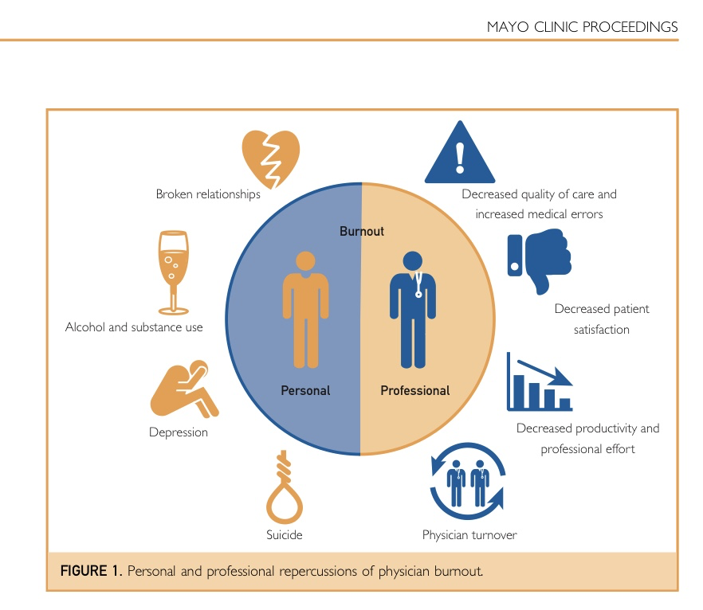

Slide 23
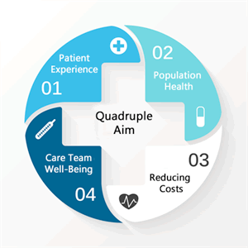

Slide 24
Definition of Burnout
Overwhelming emotional exhaustion
Depersonalization – feelings of cynicism and detachment from the job
Perception of ineffectiveness and lack of personal accomplishment

Slide 25
Two Questions
I feel burned out from my work. (emotional exhaustion)
I have become more callous toward people since I took this job. (depersonalization)

Slide 26
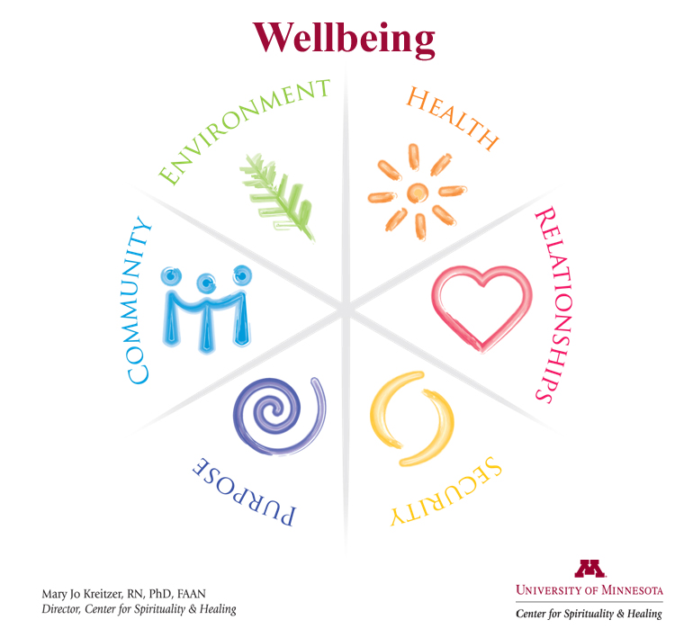
Culture of Wellbeing
Support employees in creating personal plans for health and wellbeing.
Staff and Leadership Education
System Improvements

Slide 27
Why Wellbeing?

Slide 28
Move Beyond “Fixing” Health Care… Building Capacity in People, Organizations and Communities

Slide 29
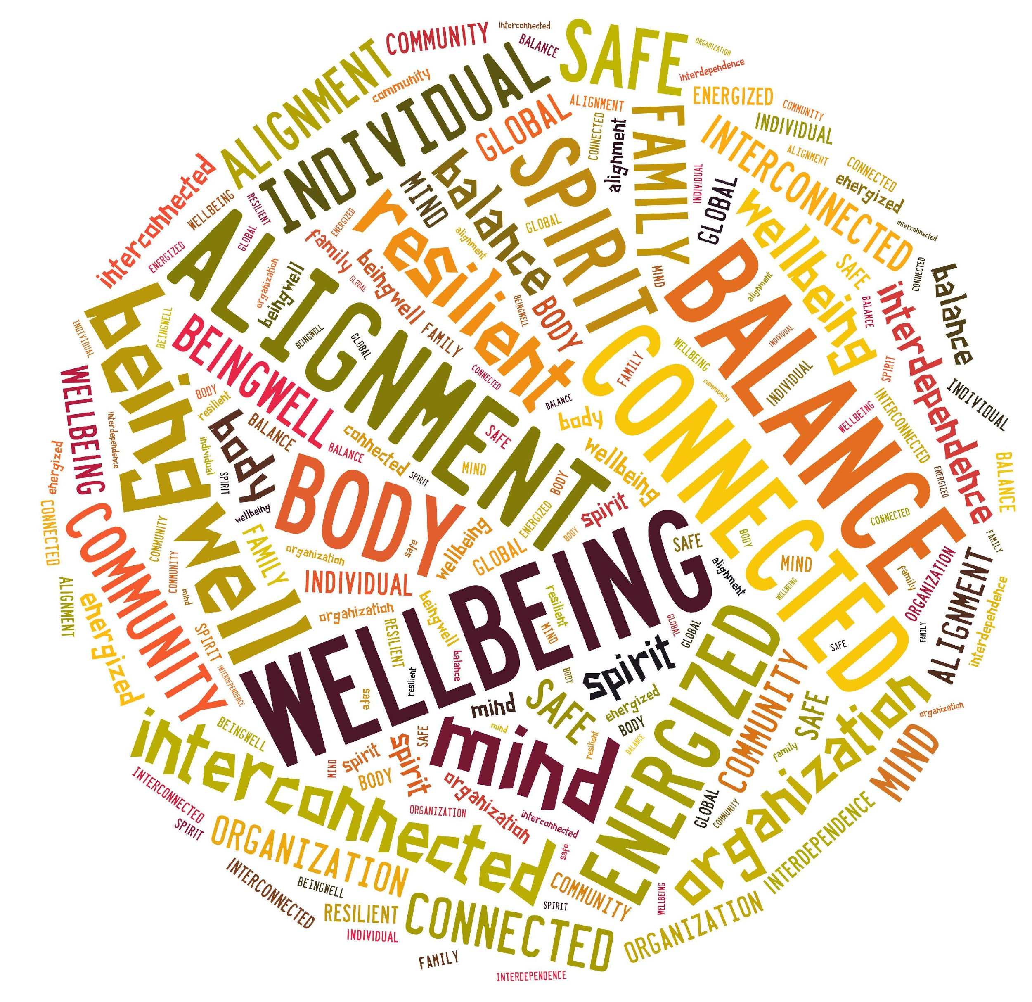

Slide 30
Defining Wellbeing
Happy, healthy and prosperous
A state of being in balance or alignment
Content
Peaceful
Connected to purpose
In harmony
Safe
Notes:
Reality of U.S. Healthcare costs – spending more, poorer outcomes and limited access.
Higher self-reported wellbeing associated with fewer hospitalizations, ER visits and medications (Population Health Management 2012).
30 years of Gallop Polls in 150 countries – sample of 98% of the population. Only 7% are thriving in all of their identified areas (which are univesral across nationalities, faiths and cultures): Love for what we do (Purpose), Relationship, Security of finances, Vibrancy of Physical Health, Pride in what we have contributed to community.

Slide 31
Whole

Slide 32
What Impacts your Wellbeing?

Slide 33
Gallup Organization
More than 98% of the world’s population
Only 7% of people are thriving in all areas.
Elements universal across faiths, cultures and nationalities.

Slide 34
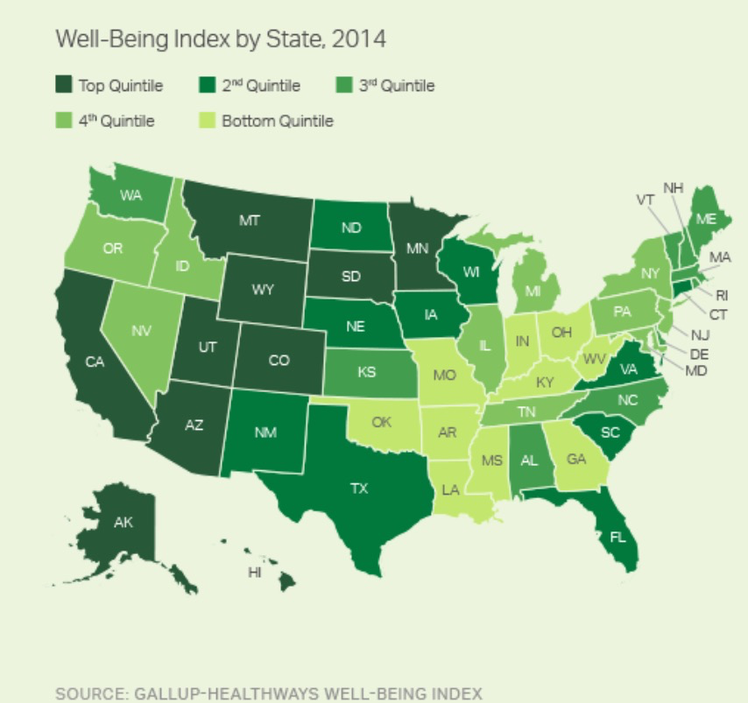

Slide 35
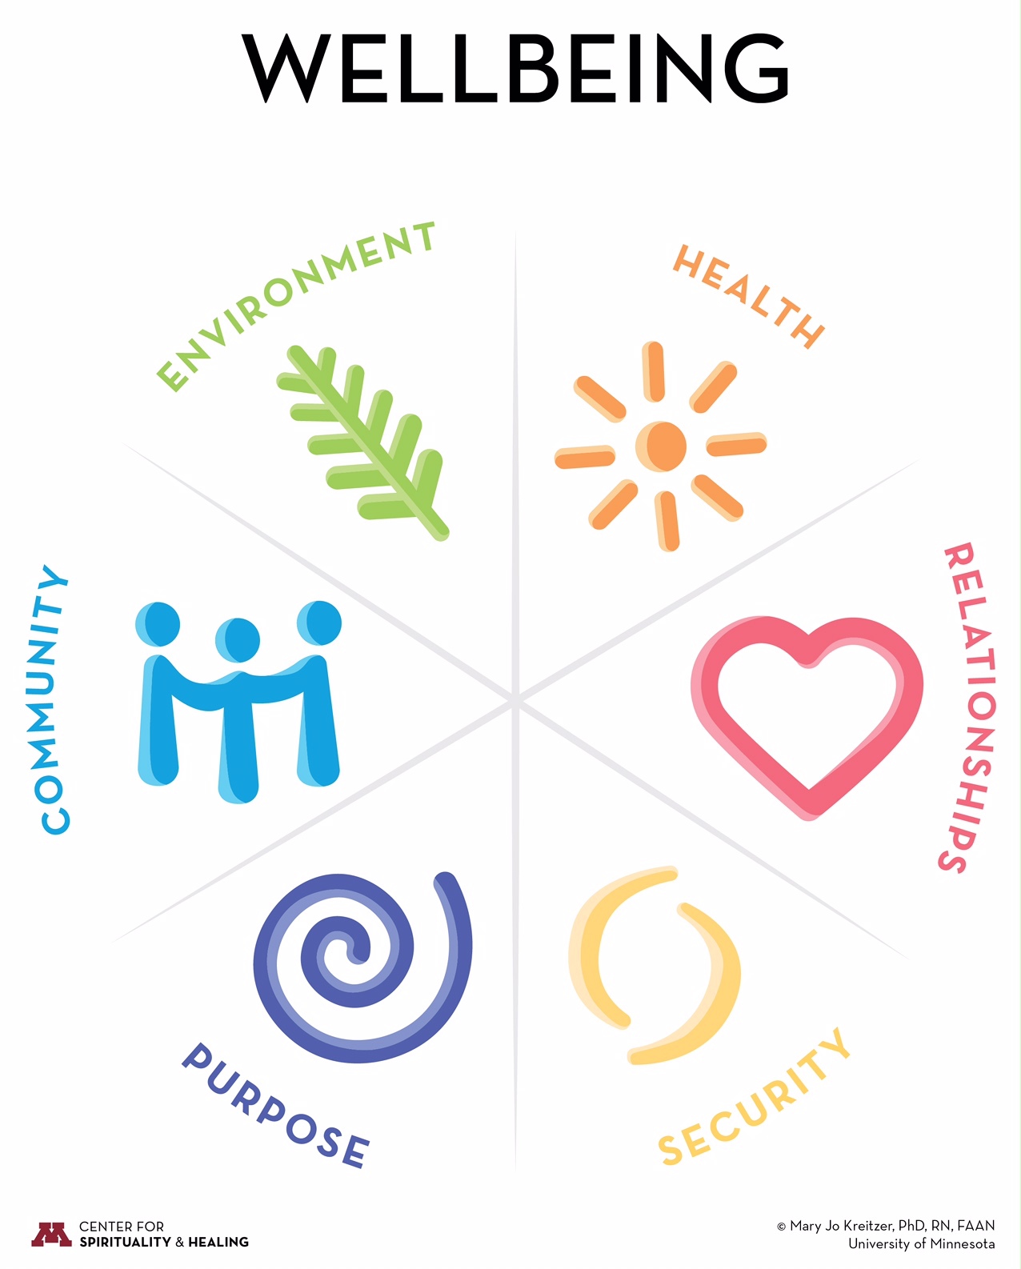
Whole person
Increase capacity and expand potential
Possible even with chronic illness and maturing bodies
Individual, family, organization and community
Notes:
Wellbeing is not just another word for physical health—it is about finding balance in body, mind, and spirit. In this state, we feel content, connected, energized, resilient, and safe.
Wellbeing is possible even in the midst of chronic or life-threatening illness, with maturing bodies and minds that struggle with dementia. It’s about addressing the whole person where they are and increasing capacity within that person’s limits.
Our model of wellbeing was created by Dr. Mary Jo Kreitzer, Director of the Center for Spirituality and Healing, at the University of Minnesota. In her extensive work and research around integrative health and healing, Dr. Kreitzer identified six dimensions that contribute to wellbeing.These take into account our interconnectedness and interdependence with our friends, families, and communities, as well as the personal and global environment we live in. They also address the importance of security and purpose in our lives.
The model can be conceptualized and expressed at many levels—including the individual, family, organization/system, and community.

Slide 36
Physical Health
Emotional Health
Mental Health
Spiritual Health
Notes:
Health is affected by the food we eat, how often we exercise, how we manage our stress, and how much we sleep, as well as social, environmental, and genetic influences. Lifestyle choices are responsible for nearly 90% of health outcomes.
Physical Activity: Don’t just sit there—move your body to prevent and reduce the risk of many diseases, improve physical and emotional health, and live a longer life. Note: Matthew Sanford – physical health does not equal wellbeing.
Diet: Your food choices have a bigger effect than you think. Nutritious meals and mindful eating can foster your own wellbeing and have a positive impact on your environment and the people around you.
Sleep: Don’t underestimate the importance of sleep, which has far-reaching effects on your mood, ability to concentrate, connections to others, and even your weight.
Thoughts & Emotions: Learn to recognize how your thoughts and emotions make a difference —in your physical and mental health, relationships, and overall wellbeing—and how to cultivate a more positive outlook.
Stress Mastery: Feeling overwhelmed? Learning to recognize your stressors can help you control how you respond to them, leading to a more relaxed, healthier life.

Slide 37
Physical Activity and Fitness
Diet & Nutrition
Sleep
Thoughts and Emotions
Stress Mastery
“Health is in your hands.”
Notes:
Health is affected by the food we eat, how often we exercise, how we manage our stress, and how much we sleep, as well as social, environmental, and genetic influences. Lifestyle choices are responsible for nearly 90% of health outcomes.
Physical Activity: Don’t just sit there—move your body to prevent and reduce the risk of many diseases, improve physical and emotional health, and live a longer life. Note: Matthew Sanford – physical health does not equal wellbeing.
Diet: Your food choices have a bigger effect than you think. Nutritious meals and mindful eating can foster your own wellbeing and have a positive impact on your environment and the people around you.
Sleep: Don’t underestimate the importance of sleep, which has far-reaching effects on your mood, ability to concentrate, connections to others, and even your weight.
Thoughts & Emotions: Learn to recognize how your thoughts and emotions make a difference —in your physical and mental health, relationships, and overall wellbeing—and how to cultivate a more positive outlook.
Stress Mastery: Feeling overwhelmed? Learning to recognize your stressors can help you control how you respond to them, leading to a more relaxed, healthier life.

Slide 38
Food and Health
Four of the top ten causes of death today are chronic diseases with well-established links to diet: Coronary artery disease, diabetes, stroke, and cancer.

Slide 39
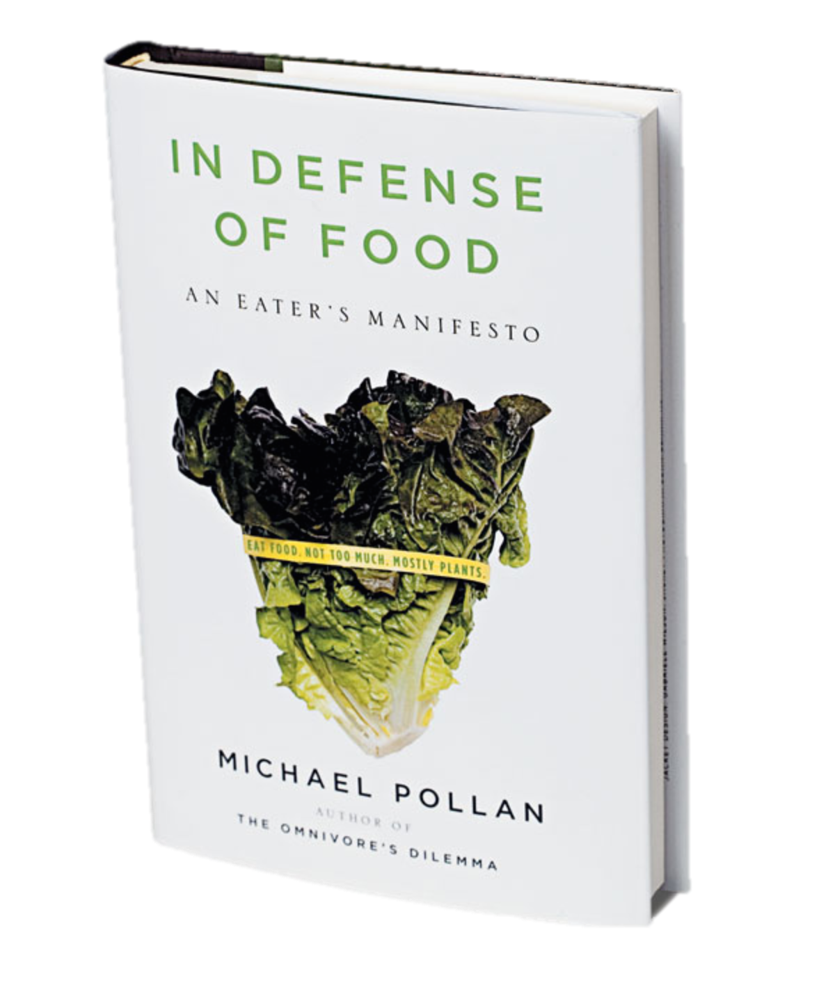

Slide 40
3 Simple Rules

Slide 41
Eat Food
Food vs. edible food-like substances
Avoid food that has been processed to such an extent that it is more a product of industry than nature.
Quality vs. quantity – we now have human beings that are both overfed and undernourished.

Slide 42
Eat Food
Avoid food products containing ingredients that are unfamiliar, unpronounceable, more than five in number, or that include high-fructose corn syrup.
Avoid food products that make health claims.

Slide 43
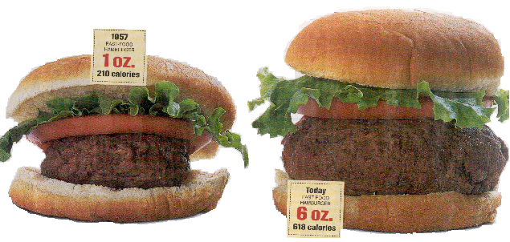
Not Too Much

Slide 44
Not Too Much
Eat until you are 80% full.
Do your eating at a table.
Try not to eat alone.
Eat slowly.

Slide 45
Mostly Plants
Benefits of a plant-based diet – about the only point of consensus.
Fiber, antioxidants and omega-3-fatty acids
Thomas Jefferson – use meat as a condiment for vegetables.

Slide 46
Eating and Emotions
Do you eat to relieve stress, unhappiness, or other emotions?
Life is Hard, Food is Easy by Linda Spangle

Slide 47
Exercise and Fitness
Sedentary Society
Health Risks of Inactivity

Slide 48
Why Exercise?
Decrease risk of disease.
Improve physical, mental and social wellbeing.
Sleep better
Live longer
Enjoy leisure activities
Avoid injury
Maintain healthy weight

Slide 49
Exercise and Fitness Guidelines
30 minutes of moderate exercise most, if not all, days of the week.
To obtain even greater health benefits, engage in more vigorous physical activity or for a longer duration.
Cardiovascular conditioning, stretching, strength training and balance

Slide 50
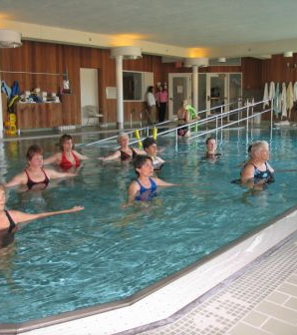
Exercise and Fitness
Find something that you enjoy and are committed to doing on a regular basis.

Slide 51
Exercise and Fitness
Vary your routine to avoid boredom

Slide 52
Exercise and Fitness
10,000 step program
Using a pedometer or other electronic device

Slide 53
Stress Mastery
Stress and Health
- Stress impact every system of the body
Psychoneuroimmunology
- Mind/Body connection

Slide 54
Stress Mastery
Identify sources of stress in your life
Become aware of where you hold your stress
Learn ways to manage stress

Slide 55
Stress Mastery
Meditation, Tai Chi
Expressive Arts Therapies
Hobbies
Breathing Techniques
Imagery
Bodywork
Exercise
Labyrinth
Social Support

Slide 56
Mindfulness
Being in the present moment, with a non-judging, non-striving attitude of acceptance.

Slide 57
Mindfulness Pause

Slide 58
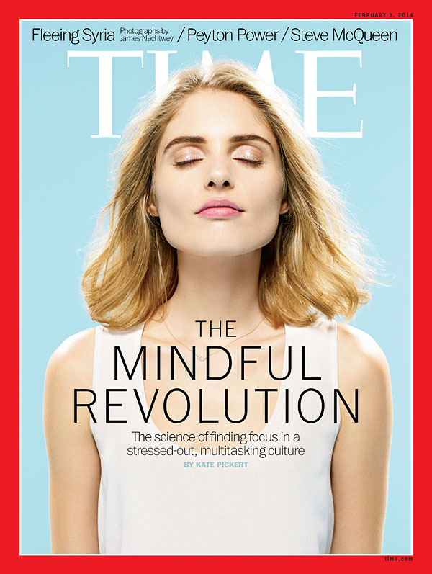

Slide 59
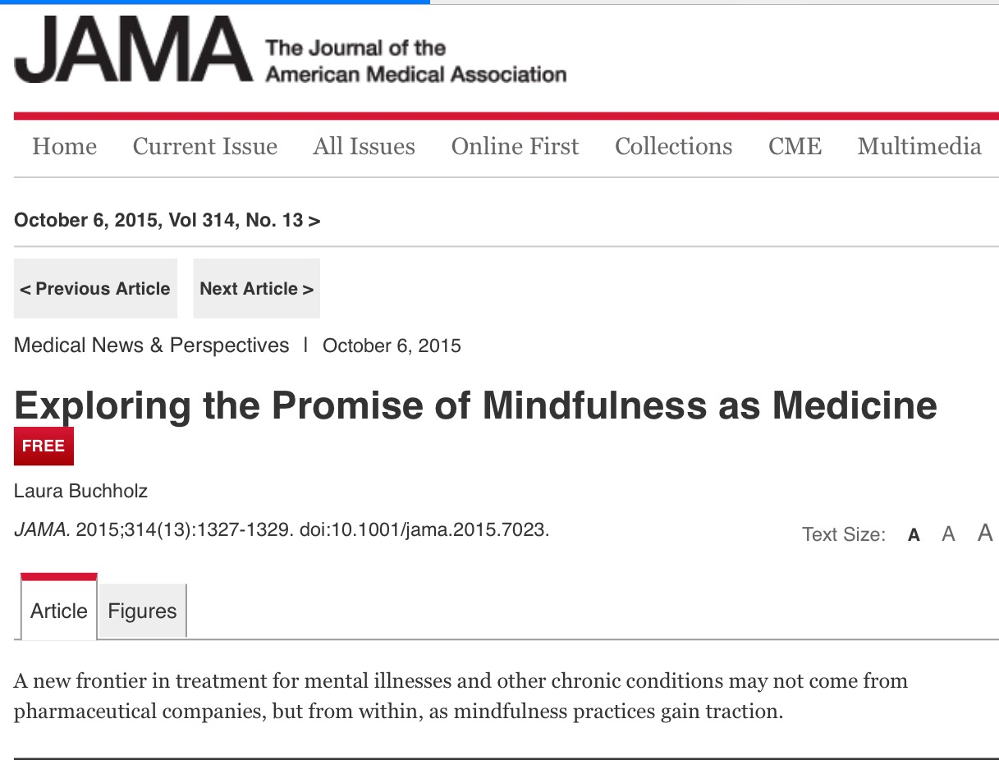

Slide 60
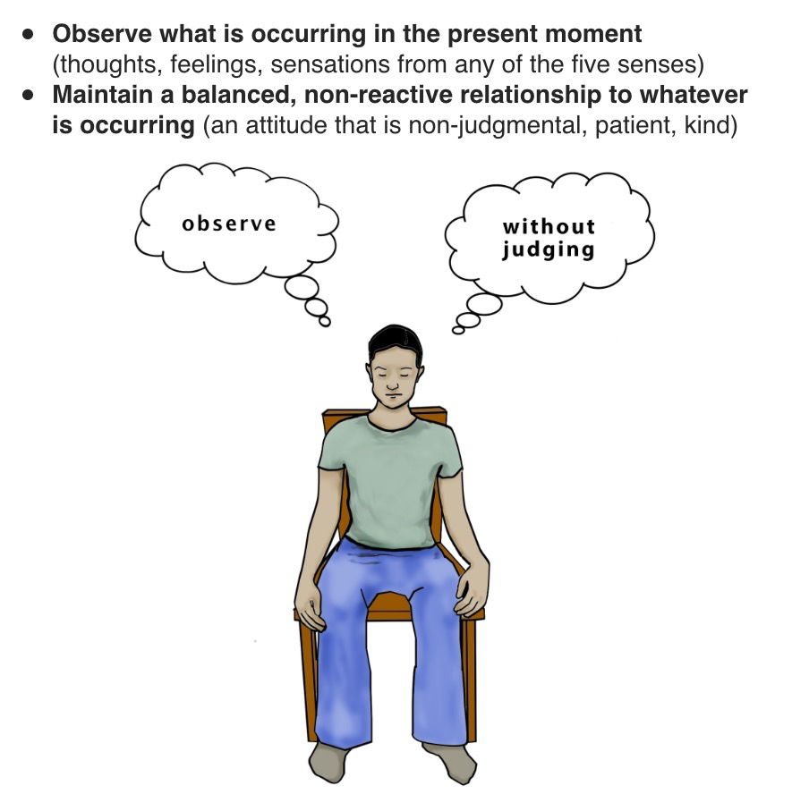

Slide 61
Mindfulness
Mindfulness is a way to cultivate our capacity to be fully present.
It is not a technique, it is a way of being.

Slide 62
Mindfulness
Think about a recent encounter you had with a family member, friend, clerk, work colleague ….were you truly present?

Slide 63
Mindfulness
Business
Education
Health Care
Military

Slide 64
Why is being mindful so difficult?
We live in a world of multi-tasking with expectations of high productivity.
We have been conditioned from a young age to live in the future.

Slide 65
Emotions and Attitudes
Impact on Health
- Anger and Cynicism
- Hopelessness and Mortality
- Positive psychological states
- Negative attitudes and immune system
- Forgiveness

Slide 66
What Gets You Up In The Morning?
Aim
Direction
Different from job or career
“Purpose matters.”
Notes:
Purpose guides life decisions, influences behavior, shapes goals, offers a sense of direction, and creates meaning. Purpose is directly related to both health and happiness, and it has a major impact on our wellbeing. Purpose can be different from a job or career and in an older population needs to be redefined. Retirement with no purpose leads to death.
Life Purpose: Why do you get up in the morning? Knowing your own answers to this question can help you live a more engaged, fulfilled life.
Spirituality: Experiencing a connection to something larger than yourself can offer a sense of meaning in life and provide comfort to help you cope with life’s challenges.

Slide 68
Be more reflective.
Be more courageous.
Be clear earlier about purpose!
Notes:
Purpose guides life decisions, influences behavior, shapes goals, offers a sense of direction, and creates meaning. Purpose is directly related to both health and happiness, and it has a major impact on our wellbeing. Purpose can be different from a job or career and in an older population needs to be redefined. Retirement with no purpose leads to death.
Life Purpose: Why do you get up in the morning? Knowing your own answers to this question can help you live a more engaged, fulfilled life.
Spirituality: Experiencing a connection to something larger than yourself can offer a sense of meaning in life and provide comfort to help you cope with life’s challenges.

Slide 69
Gifts
Values
Passions
Needs in the world
Your “Calling”
Notes:
Purpose guides life decisions, influences behavior, shapes goals, offers a sense of direction, and creates meaning. Purpose is directly related to both health and happiness, and it has a major impact on our wellbeing. Purpose can be different from a job or career and in an older population needs to be redefined. Retirement with no purpose leads to death.
Life Purpose: Why do you get up in the morning? Knowing your own answers to this question can help you live a more engaged, fulfilled life.
Spirituality: Experiencing a connection to something larger than yourself can offer a sense of meaning in life and provide comfort to help you cope with life’s challenges.

Slide 70
Purpose, Wellbeing, and Longevity
Study of over 6,000 people funded by the NIA, researchers found that people who had a greater sense of purpose and direction in life were more likely to outlive their peers.
People with a sense of purpose had a 15% lower risk of death compared to those who said they were aimless.
(Hill et al, 2014)

Slide 71
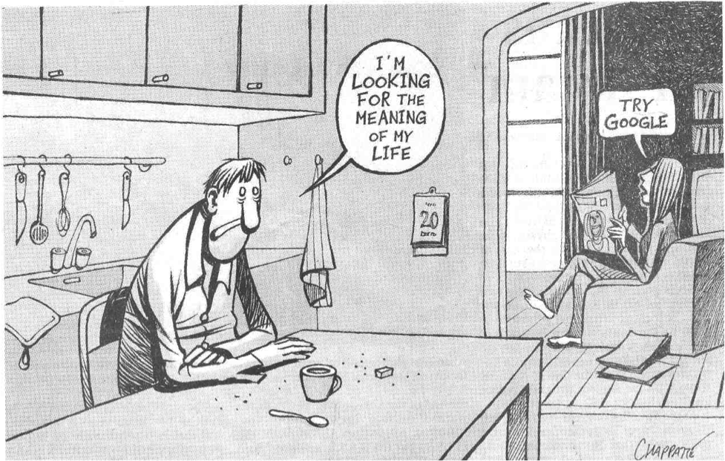

Slide 72
Close connections between people, formed by emotional bonds and interactions.
Health risks of being alone are comparable in magnitude to the risks associated with cigarette smoking, high blood pressure and obesity.
“Isolation is fatal.”
Notes:
Healthy relationships are a vital component of overall health. We humans are social animals and as such, we have an innate need to be involved with other people. Strong family ties and friendships can increase our sense of security and self-esteem and provide a psychological buffer against stress, anxiety, and depression.
Health risks of being alone or isolated are compatible with the risks associated with smoking, high blood pressure and obesity.
Our larger social networks can also provide a sense of connection where people can share their concerns and support others. We cover these broader social connections in the Community section.

Slide 73
Are there people you are close to – family, friends?
Are there people you can turn to when you are ….
Are you personal relationships balanced in terms of giving and receiving?
Notes:
Healthy relationships are a vital component of overall health. We humans are social animals and as such, we have an innate need to be involved with other people. Strong family ties and friendships can increase our sense of security and self-esteem and provide a psychological buffer against stress, anxiety, and depression.
Health risks of being alone or isolated are compatible with the risks associated with smoking, high blood pressure and obesity.
Our larger social networks can also provide a sense of connection where people can share their concerns and support others. We cover these broader social connections in the Community section.

Slide 74
Share your feelings
Listen deeply
Avoid assumptions
Build trust
Allow yourself to be vulnerable
Manage conflict

Slide 75
Qualities of a Healthy Community
Livability
Equity
Connectedness

Slide 76
Livability and Equity
Economic
Social
Cultural
Political
Technological
e.g. - jobs, schools, transportation, crime, internet access, theaters, green space

Slide 77
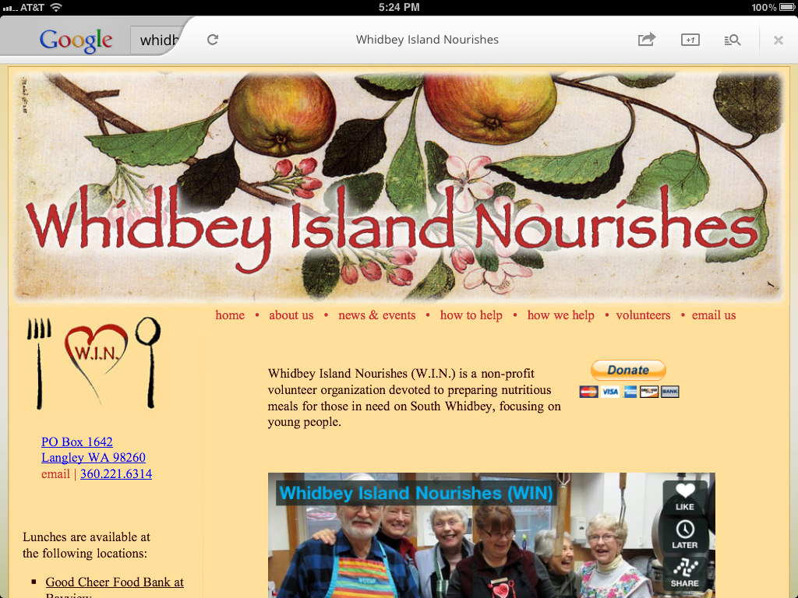
Engagement
Participation
Connections
Empowerment
Moved to action
Networks of citizen efforts
Notes:
So what do we mean by community?
In our wellbeing model, we are talking about societal groups that live in a defined geographical area and share physical and governmental resources. This kind of community exists at different levels, from neighborhoods to towns to states and countries.
Community wellbeing is an interesting concept because it exists in the wellbeing of both:
the individuals who make up that community
the larger “superorganism” of the community (and in the norms and habits that arise within that community)
Connection is fostered by a community’s social networks that:
Offer social support
Enhance social trust
Support members living harmoniously together
Foster civic engagement
Empower members to participate in community and democracy
A livable community is supported by the infrastructure, including:
Housing
Transportation
Education
Parks and recreation
Human services
Public safety
Access to culture and the arts
An equitable community is supported by values of diversity, social justice, and individual empowerment, where:
All members are treated with fairness and justice
Basic needs are met (adequate access to health services, decent housing, food, personal security)
There is equal opportunity to get education and meet individual potential

Slide 78
People living in American cities with low wellbeing are twice as likely to have a heart attack as those who live in a city with high wellbeing.
“Community nurtures and sustains us.”
Notes:
So what do we mean by community?
In our wellbeing model, we are talking about societal groups that live in a defined geographical area and share physical and governmental resources. This kind of community exists at different levels, from neighborhoods to towns to states and countries.
Community wellbeing is an interesting concept because it exists in the wellbeing of both:
the individuals who make up that community
the larger “superorganism” of the community (and in the norms and habits that arise within that community)
Connection is fostered by a community’s social networks that:
Offer social support
Enhance social trust
Support members living harmoniously together
Foster civic engagement
Empower members to participate in community and democracy
A livable community is supported by the infrastructure, including:
Housing
Transportation
Education
Parks and recreation
Human services
Public safety
Access to culture and the arts
An equitable community is supported by values of diversity, social justice, and individual empowerment, where:
All members are treated with fairness and justice
Basic needs are met (adequate access to health services, decent housing, food, personal security)
There is equal opportunity to get education and meet individual potential

Slide 79
Basic Human Needs
Job
Finances
Safety and Prevention
“Fear immobilizes.”
Notes:
At its most basic level, security means freedom from fear, especially our most basic fears around health, personal safety, and financial stability. Because fear can immobilize and incapacitate us, security is essential to our wellbeing.
Facing Fear: At its most basic level, security means freedom from fears that constrict us. To have true wellbeing in our lives, we need to face our fears and anxieties.
Rethinking Money: Our society tells us that money brings happiness. But research suggests that isn’t always true and that we should rethink the role of money in our lives.
Safety and Prevention: One of the most important things you can do for your wellbeing is to make wise decisions that keep yourself safe and healthy.

Slide 80
Face your fears and anxieties so they don’t become debilitating.
Identify ways to create a sense of personal control or mastery.

Slide 81
Clean air and water
Free of toxins
Built environment
Access to nature
Notes:
Think of the environment as concentric rings starting with your home and workplace and widening out to your neighborhood, your region, the entire planet. At each level, environmental factors impact human health. At each level, we impact the environment with our choices and actions. This not only includes the quality of the air and water, but also the quality of our relationship with nature.
Personal Environment: Environment free of toxins. The air you breathe, the water you drink, and even the noise levels in your personal spaces all impact your health in an immediate way.
Nature and Us: Access to nature – biophilia. In addition to meeting some of our most basic needs, nature relaxes, refreshes, and heals us. In turn, we need to work to heal nature.
Global Environment: Almost every choice you make affects the environment on some level. Working to create a sustainable lifestyle benefits the whole planet.

Slide 82
Creating Healing
Environments in
work and at home

Slide 83
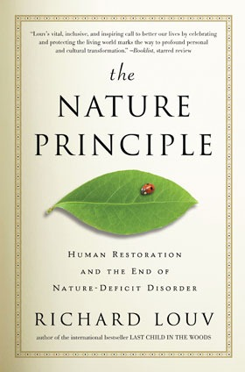
Nature Heals

Slide 84
Nature Contact and Human Health
Humans are increasingly disconnected from nature.
Over half of the world’s population and 4/5 Americans leave in urban areas where access to nature may be limited.
Americans spend 90% of their time indoors, most of the time in buildings.
Total media consumption for US adults in 2016 – 10 hours and 39 minutes daily.
(Fumkin et al, 2017)

Slide 85
Benefits of Nature Contact
Reduced stress
Improved sleep
Decreased anxiety and depression
Greater happiness and life satisfaction
Reduced aggression
(Fumkin et al, 2017)

Slide 86
Organizational Wellbeing
NYT article “Why you hate work” – May 2014
Gallup Poll – only 30% of employees in America feel engaged at work.
White-Collar Salt Mines
For most, work is a depleting, dispiriting experience that is getting worse.
Notes:
Culture of Wellbeing rests on employee wellbeing.
Wellbeing leadership: A whole systems approach to improving the wellbeing of individuals, teams and organizations that focuses on personal growth, whole systems leadership and organizational transformation.

Slide 87
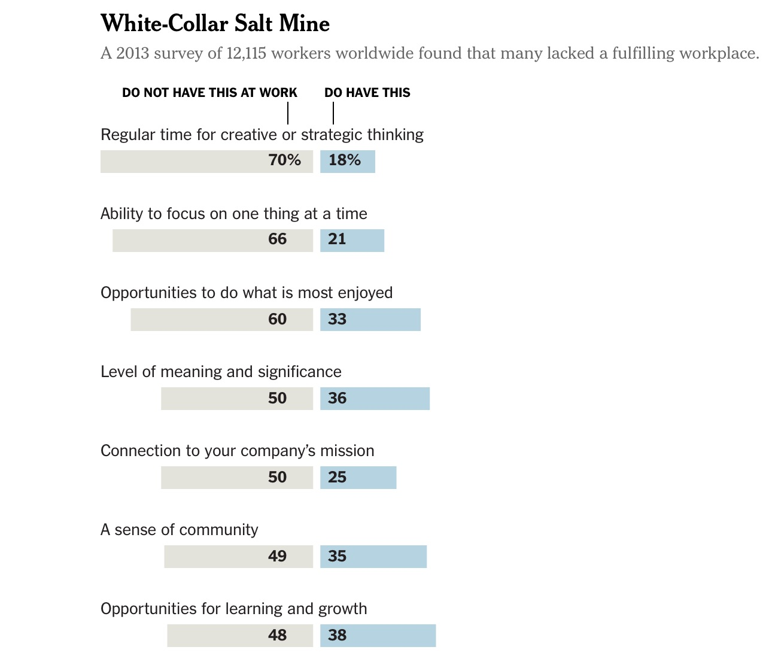

Slide 88
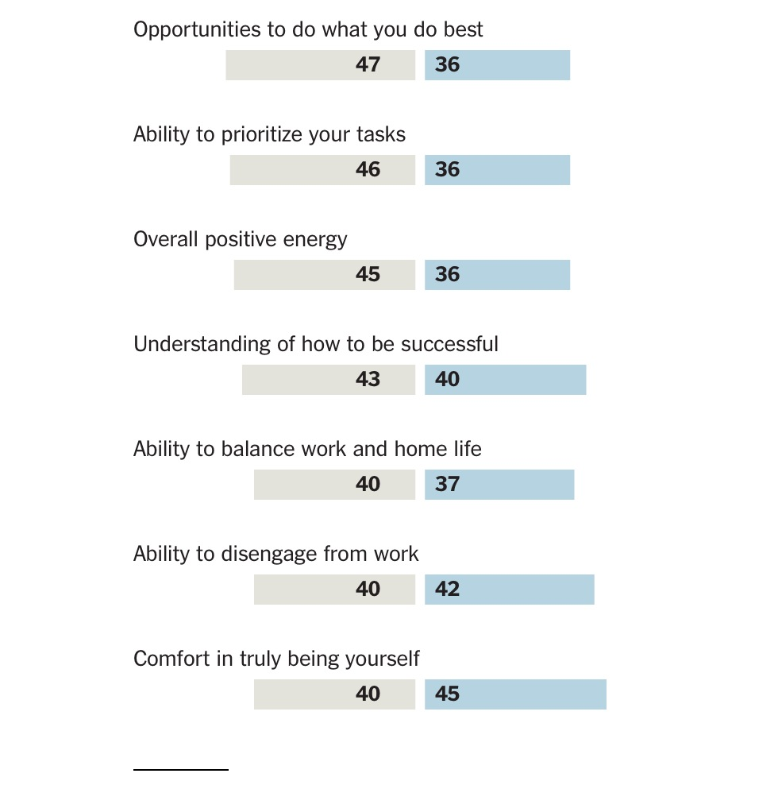

Slide 89
Financial health and viability
Ethics and sustainability of business practices
Workload
Clarity of roles and responsibilities
Population health
Notes:
Health is affected by the food we eat, how often we exercise, how we manage our stress, and how much we sleep, as well as social, environmental, and genetic influences. Lifestyle choices are responsible for nearly 90% of health outcomes.
Physical Activity: Don’t just sit there—move your body to prevent and reduce the risk of many diseases, improve physical and emotional health, and live a longer life. Note: Matthew Sanford – physical health does not equal wellbeing.
Diet: Your food choices have a bigger effect than you think. Nutritious meals and mindful eating can foster your own wellbeing and have a positive impact on your environment and the people around you.
Sleep: Don’t underestimate the importance of sleep, which has far-reaching effects on your mood, ability to concentrate, connections to others, and even your weight.
Thoughts & Emotions: Learn to recognize how your thoughts and emotions make a difference —in your physical and mental health, relationships, and overall wellbeing—and how to cultivate a more positive outlook.
Stress Mastery: Feeling overwhelmed? Learning to recognize your stressors can help you control how you respond to them, leading to a more relaxed, healthier life.

Slide 90
Clarity of vision and mission
Alignment of leadership and staff
Alignment of strategic goals and resources
Opportunities for personal and professional development
Perception of challenge and control
Notes:
Purpose guides life decisions, influences behavior, shapes goals, offers a sense of direction, and creates meaning. Purpose is directly related to both health and happiness, and it has a major impact on our wellbeing. Purpose can be different from a job or career and in an older population needs to be redefined. Retirement with no purpose leads to death.
Life Purpose: Why do you get up in the morning? Knowing your own answers to this question can help you live a more engaged, fulfilled life.
Spirituality: Experiencing a connection to something larger than yourself can offer a sense of meaning in life and provide comfort to help you cope with life’s challenges.

Slide 91
Authentic connections
Recognition, respect, trust and dignity
Effective teams
Positive manager/employee relations
Engagement, retention, satisfaction and turnover
Notes:
Healthy relationships are a vital component of overall health. We humans are social animals and as such, we have an innate need to be involved with other people. Strong family ties and friendships can increase our sense of security and self-esteem and provide a psychological buffer against stress, anxiety, and depression.
Health risks of being alone or isolated are compatible with the risks associated with smoking, high blood pressure and obesity.
Our larger social networks can also provide a sense of connection where people can share their concerns and support others. We cover these broader social connections in the Community section.

Slide 92
Cohesiveness
Connections within and beyond
Strong social network
Shared purpose and meaning
Support
Reciprocity
Caring
Notes:
So what do we mean by community?
In our wellbeing model, we are talking about societal groups that live in a defined geographical area and share physical and governmental resources. This kind of community exists at different levels, from neighborhoods to towns to states and countries.
Community wellbeing is an interesting concept because it exists in the wellbeing of both:
the individuals who make up that community
the larger “superorganism” of the community (and in the norms and habits that arise within that community)
Connection is fostered by a community’s social networks that:
Offer social support
Enhance social trust
Support members living harmoniously together
Foster civic engagement
Empower members to participate in community and democracy
A livable community is supported by the infrastructure, including:
Housing
Transportation
Education
Parks and recreation
Human services
Public safety
Access to culture and the arts
An equitable community is supported by values of diversity, social justice, and individual empowerment, where:
All members are treated with fairness and justice
Basic needs are met (adequate access to health services, decent housing, food, personal security)
There is equal opportunity to get education and meet individual potential

Slide 93
Sense of equity
Stability
Clear communication and expectations
Personal safety
Culture of safety
Notes:
At its most basic level, security means freedom from fear, especially our most basic fears around health, personal safety, and financial stability. Because fear can immobilize and incapacitate us, security is essential to our wellbeing.
Facing Fear: At its most basic level, security means freedom from fears that constrict us. To have true wellbeing in our lives, we need to face our fears and anxieties.
Rethinking Money: Our society tells us that money brings happiness. But research suggests that isn’t always true and that we should rethink the role of money in our lives.
Safety and Prevention: One of the most important things you can do for your wellbeing is to make wise decisions that keep yourself safe and healthy.

Slide 94
Adequacy of resources
Built environment
Free of toxins
Access to nature
Green Practices
Culture of sustainability and stewardship
Notes:
Think of the environment as concentric rings starting with your home and workplace and widening out to your neighborhood, your region, the entire planet. At each level, environmental factors impact human health. At each level, we impact the environment with our choices and actions. This not only includes the quality of the air and water, but also the quality of our relationship with nature.
Personal Environment: Environment free of toxins. The air you breathe, the water you drink, and even the noise levels in your personal spaces all impact your health in an immediate way.
Nature and Us: Access to nature – biophilia. In addition to meeting some of our most basic needs, nature relaxes, refreshes, and heals us. In turn, we need to work to heal nature.
Global Environment: Almost every choice you make affects the environment on some level. Working to create a sustainable lifestyle benefits the whole planet.

Slide 95
Organizational Success
Research shows that the most successful, innovative organizations are built on cultures of engagement and wellbeing.
Best talent and the greatest contributions to society come not from organizations that pay the highest wages, but rather from organizations with the most effective cultures.

Slide 96
You cannot give what you don’t have. To heal, the nurse needs to be sound in body, mind and spirit.
~

Slide 97
Google - Project Aristotle

Slide 98
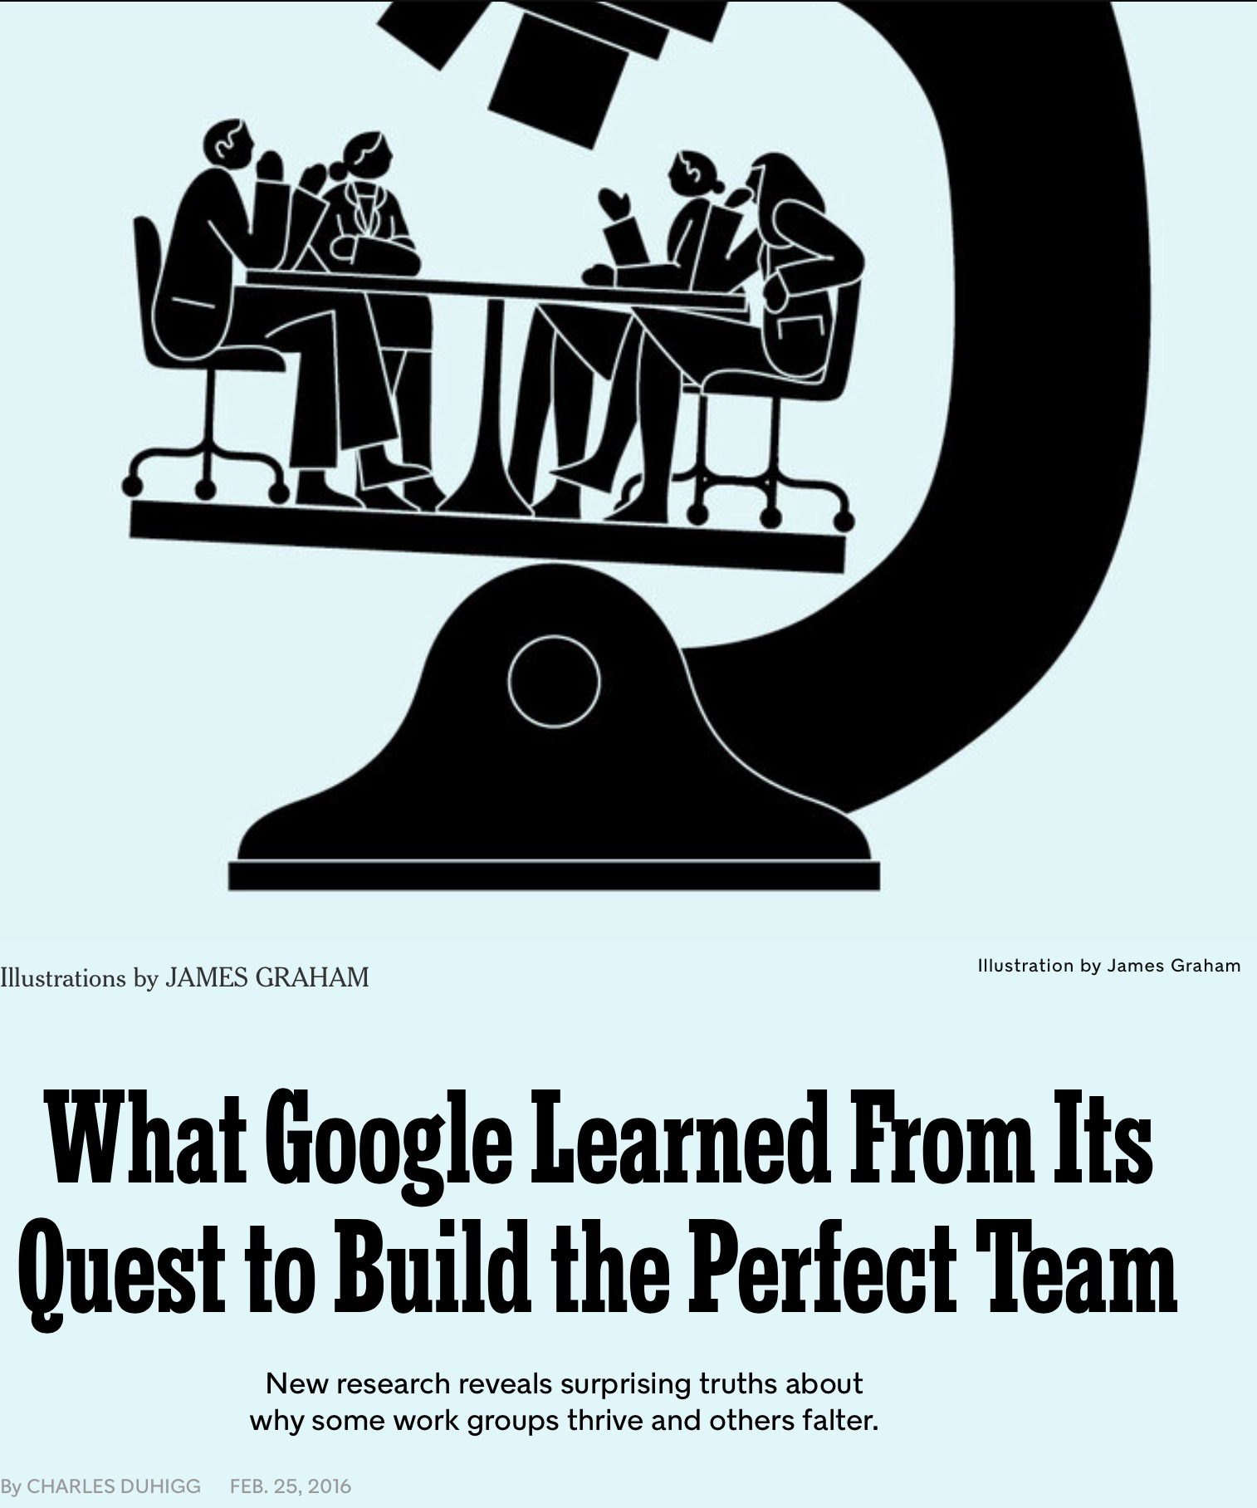

Slide 99
Power in “Groups”
Innovate faster
Find mistakes more quickly
Achieve better results
Report higher job satisfaction

Slide 100
Google’s Quest for the “Holy Grail” Project Aristotle
Long term belief – best teams were formed by the best people.

Slide 101
Project Aristotle
Statisticians, organizational psychologists, sociologists, engineers
Personality types (outgoing, shy), socializing outside of work, educational background, gender balance, manager type, hierarchical/non-hierarchical structure

Slide 102
Google’s Quest for the “Holy Grail” Project Aristotle
Most productive employees build larger networks by rotating dining companions.
Best managers share traits of good communication and avoidance of micro-managing.

Slide 103
What Mattered The Most?
KINDNESS

Slide 104
Wellbeing Leader Behaviors

Slide 105
Wellbeing Leaders
Understand the value of their own wellbeing, the wellbeing of others and the impact this has on the organization.
~
Clinical, Business and Personal Case for Wellbeing

Slide 106
Wellbeing Leaders
Develop and maintain wellbeing practices and leadership skills in the face of complexity and challenge.

Slide 107
Wellbeing Leaders
Recognize and work with patterns at a whole person and whole systems level.
~
Systems and Design Thinking

Slide 108
Wellbeing Leaders
Evoke innovative thinking and allow answers to emerge from diverse perspectives.

Slide 109
Wellbeing Leaders
Take adaptive action that transforms individuals, teams, the organization and larger community and leads to sustainable practices and results.

Slide 110
Wellbeing Leaders
Energize positive change by making wellbeing contagious!

Slide 111
Integrative nursing is a way of being-doing-knowing that advances the health and wellbeing of people, families and communities through caring and healing relationships. Integrative nurses use evidence to inform traditional and emerging interventions to support whole person and whole systems healing.

Slide 112
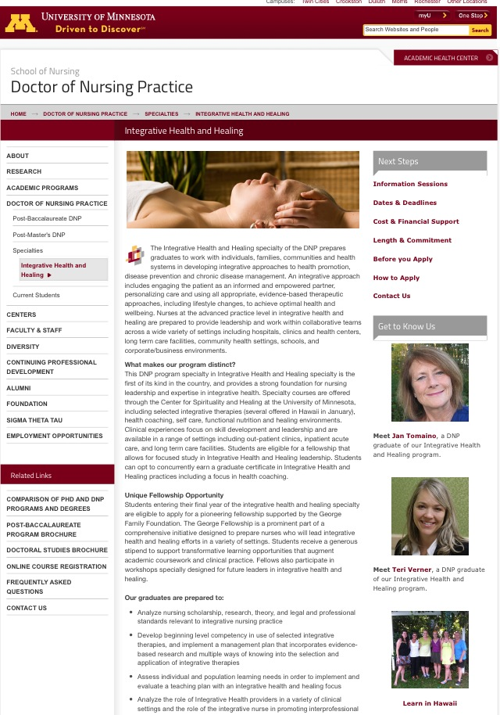
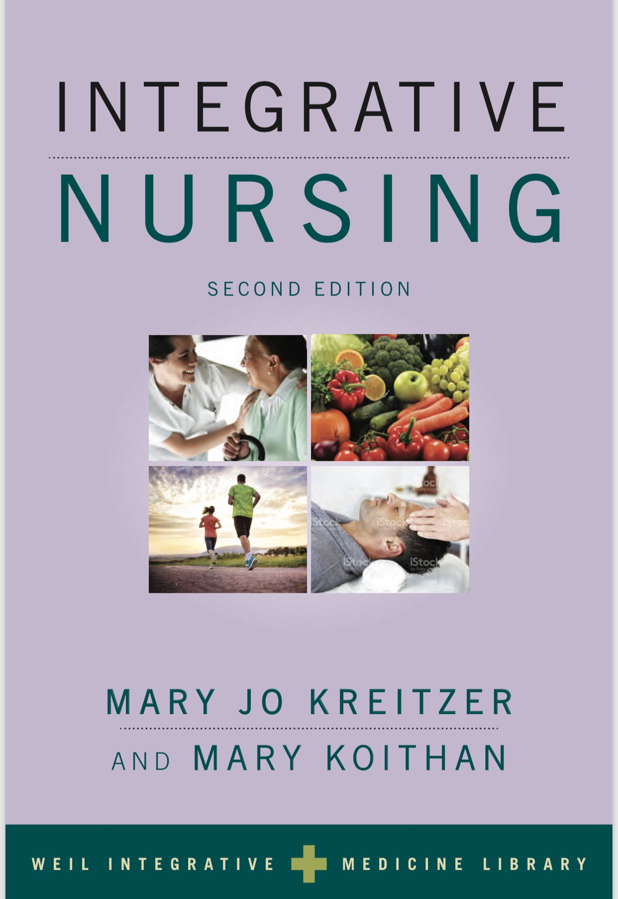
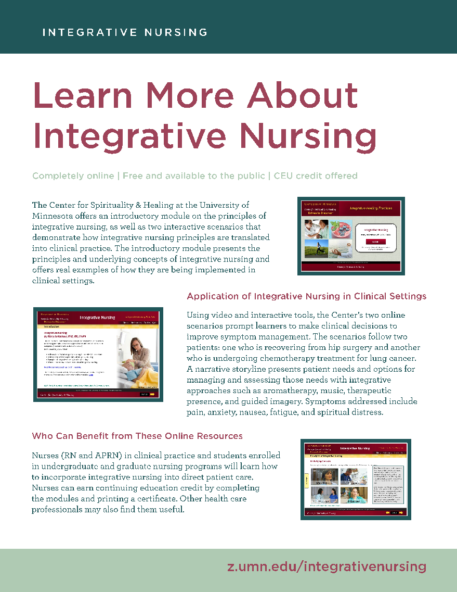
Resources
Books
Articles
Online Modules
Education

